Slide 1
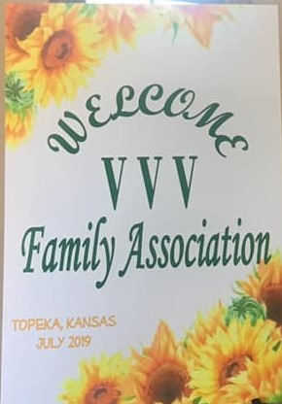
VVV Reunion July 18,19, 20, 2019 Topeka, Kansas

Slide 2
State of Kansas flag.

Slide 5
Michael and Brenda McNary residence. Location of the Thursday night gathering.

Slide 6
The welcome dinner was held at the home of Brenda and Michael McNary

Slide 8
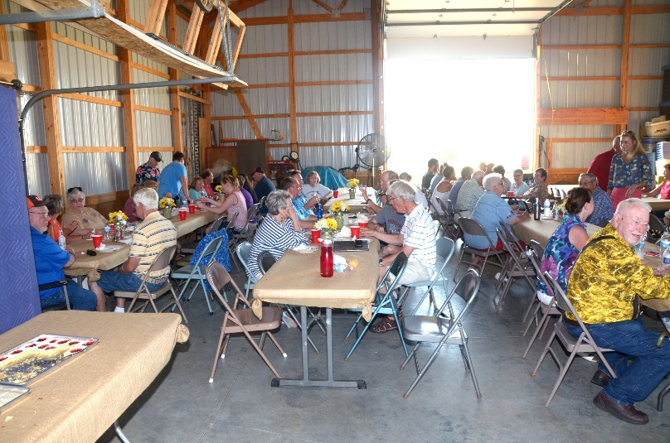
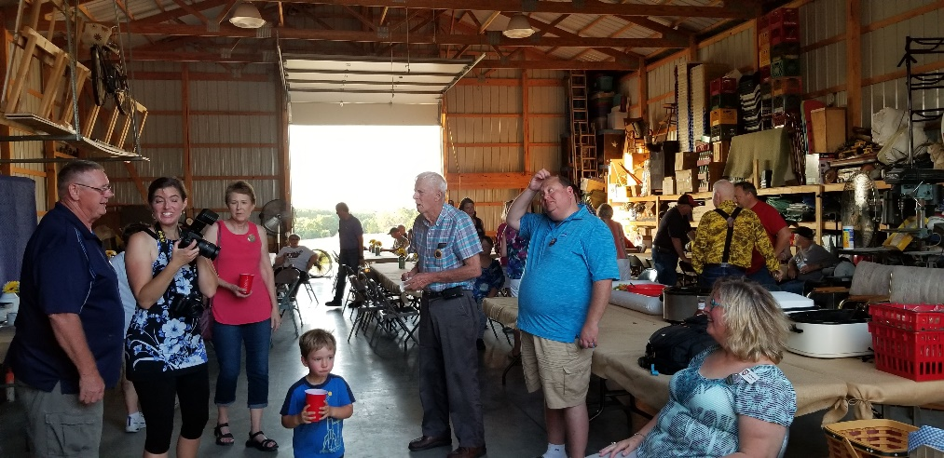
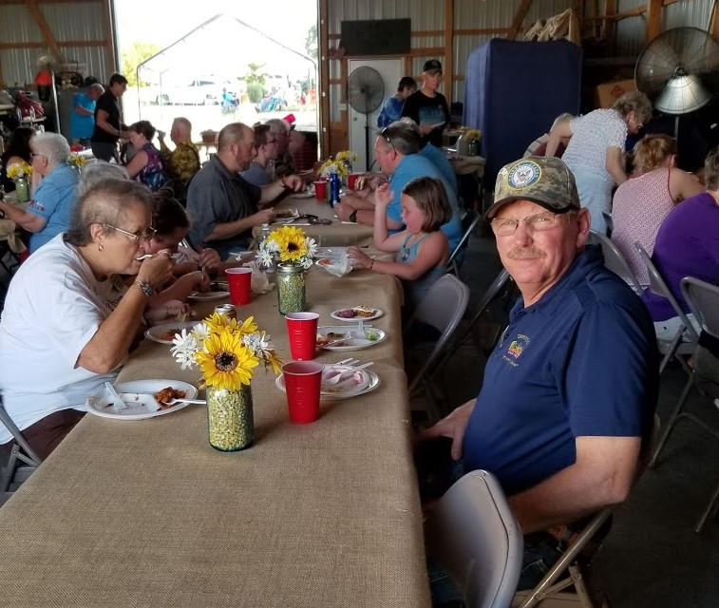

Slide 10
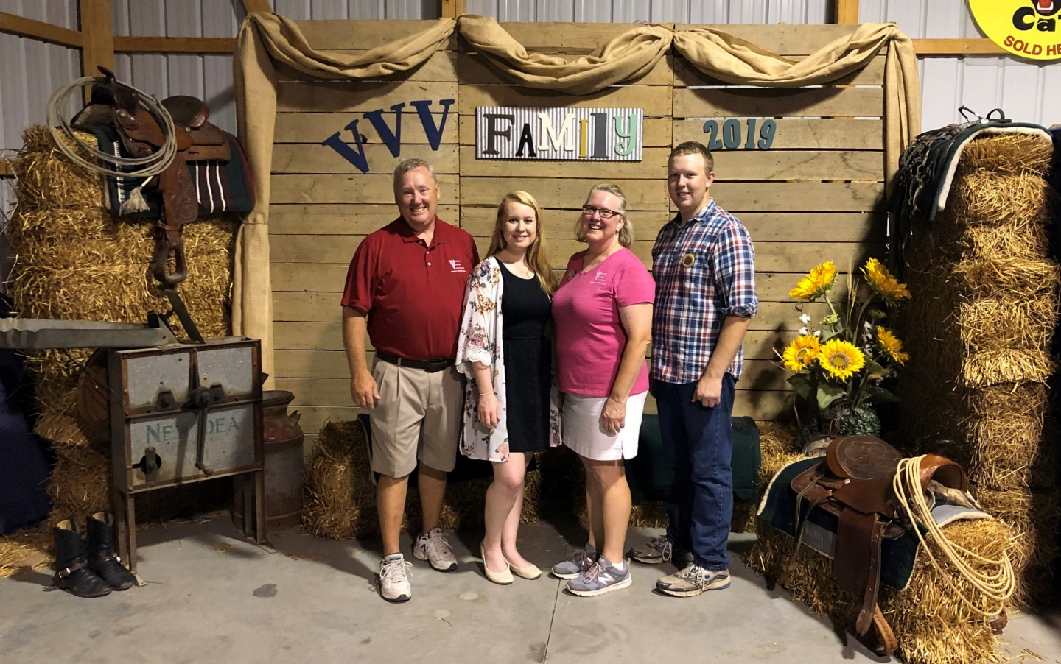
Michael McNary, John McNary, Lewis Wayne McNary, Rodney McNary, and Wanda Clark.
Michael, Jennifer, Brenda and Matthew McNary

Slide 11
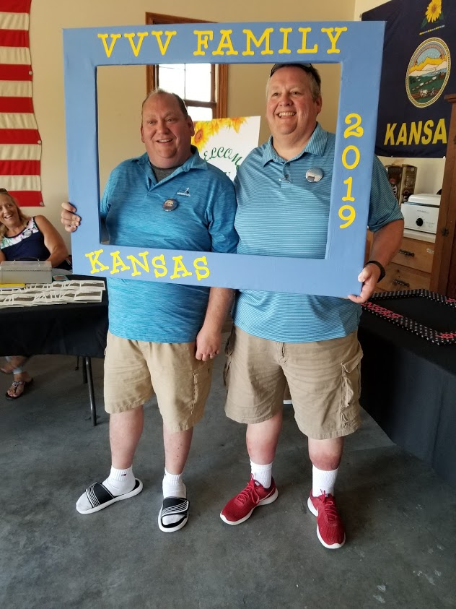
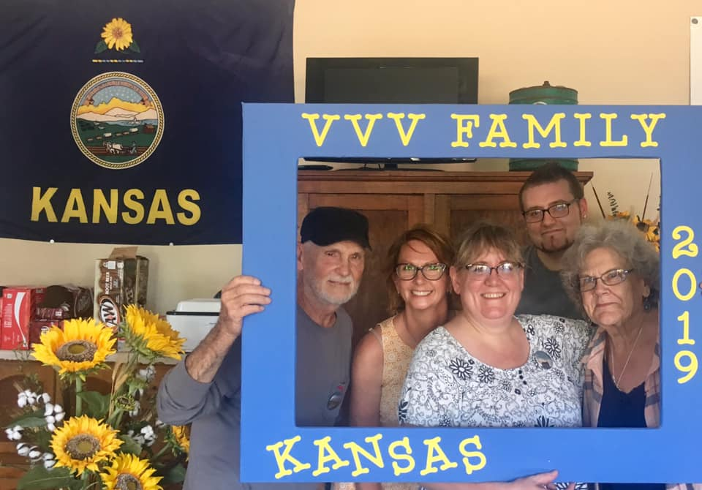
Les Vawter, Micki Self Loveland, Leslie Allen, Joshua Douglas, Laura Mumert
Randall and Bradley Collins

Slide 12
VVV President Bob Vawter and wife Janet

Slide 13
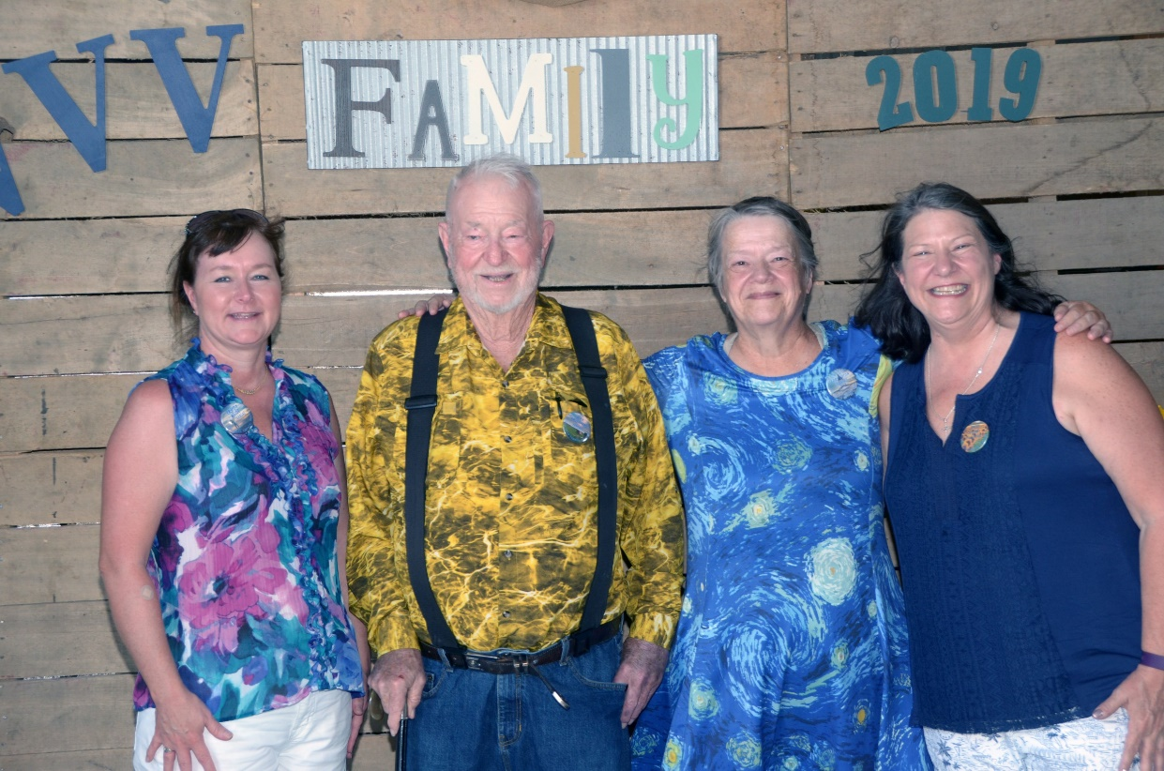
Michelle, Reba and Mike Alexander
Ray Vaughter, Terry Luton, Patti Ream
and Trudy Weide

Slide 14
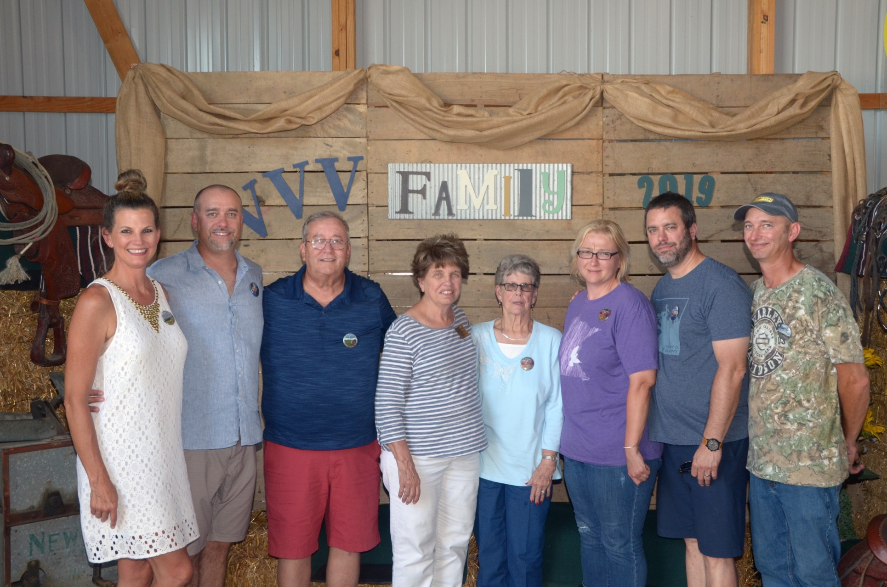
The Bugos family Denise, Chad, Paul, Connie, Sue Vawter, Michelle, Brad, Tadd

Slide 15
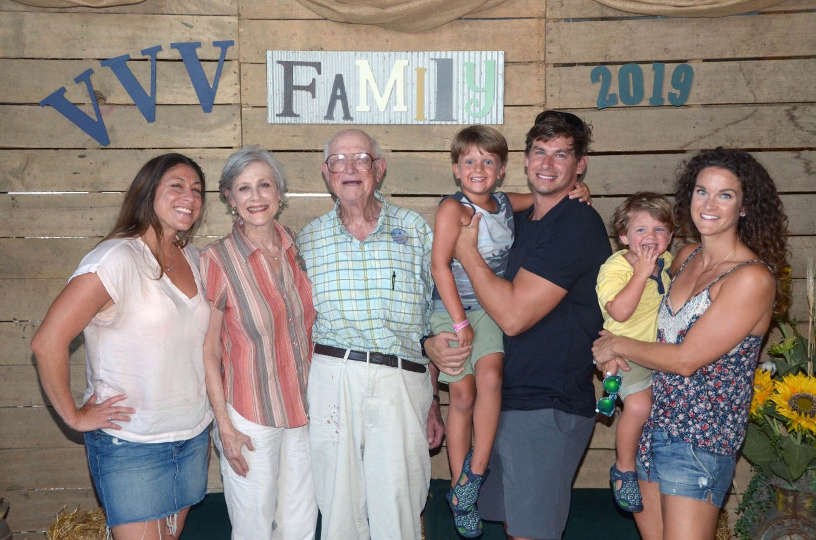
Rebecca Cummings, Ellen Wicker Cummings, Fred Wicker, Stafford Cummings, Frederick Cummings, Cullen Cummings and Becca Cummings
Fred Wicker and George Wicker

Slide 16
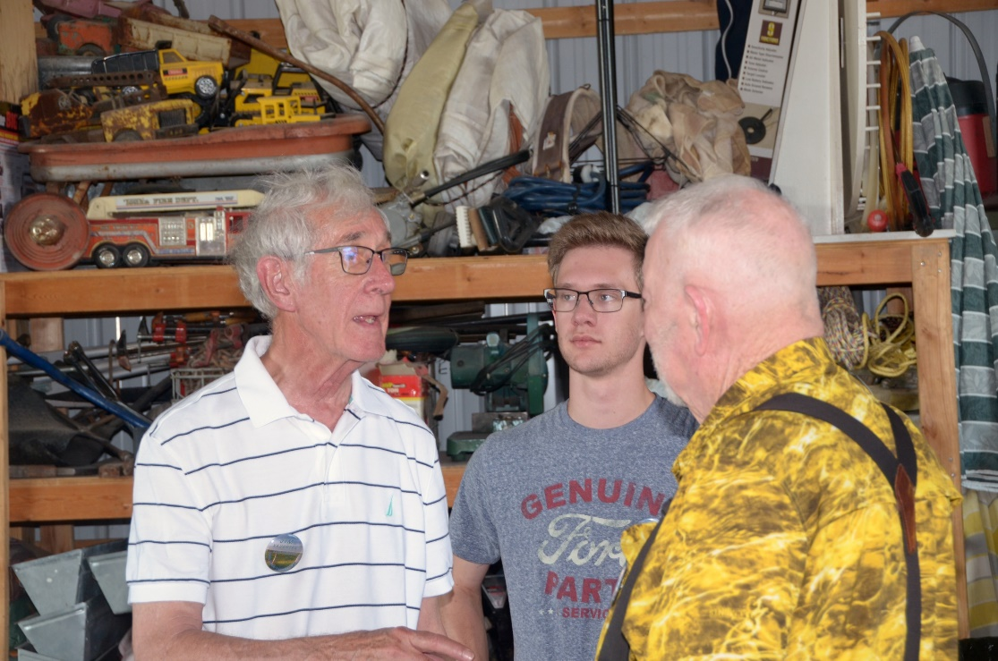
Ellen Wicker Cummings and Rebecca Cummings Jim Vaughters, Charlie Vaughters and Ray Vaughter

Slide 17
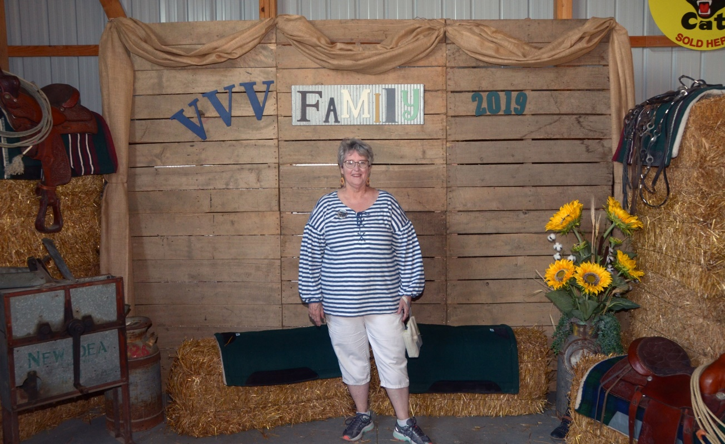
Ann Wilhelm and Marjorie Shafer
Georgene Jurgensen

Slide 18
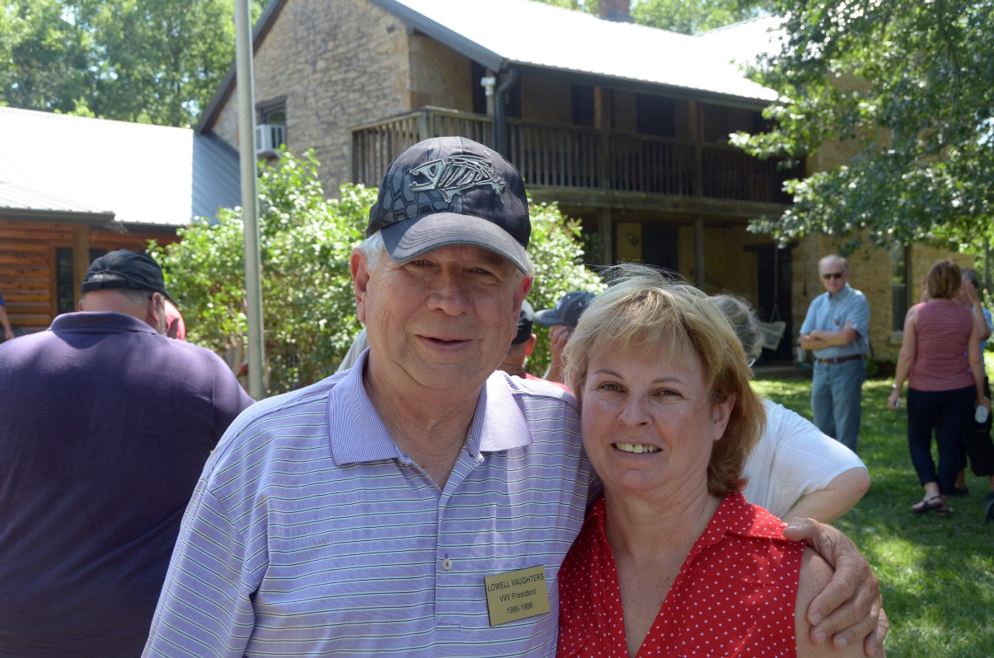
Lowell and Angela Vaughters
Judy and Jerry Aue

Slide 19
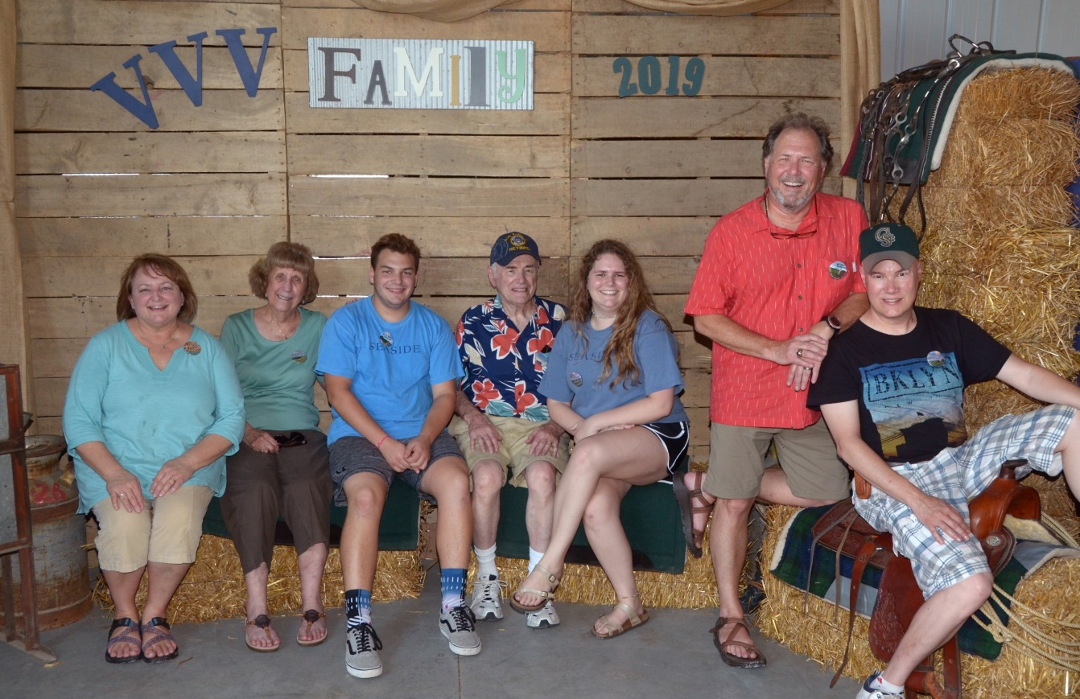
Ann Slater, Ellen Slater, David Slater, Morris Slater, Jr., Emily Slater, Wayne Slater, Mark Slater.
Front Row: Julie McMorrow and David Slater; Second row: Emily Slater, Doris Knutsen, Morris Slater, Jr., Wilma Hood, Marjorie Shafer, Mark Slater. Back row: Wayne Slater, Ann Wilhelm, Mary Wilhelm, Sheri Collie, Karyn Collie.

Slide 20
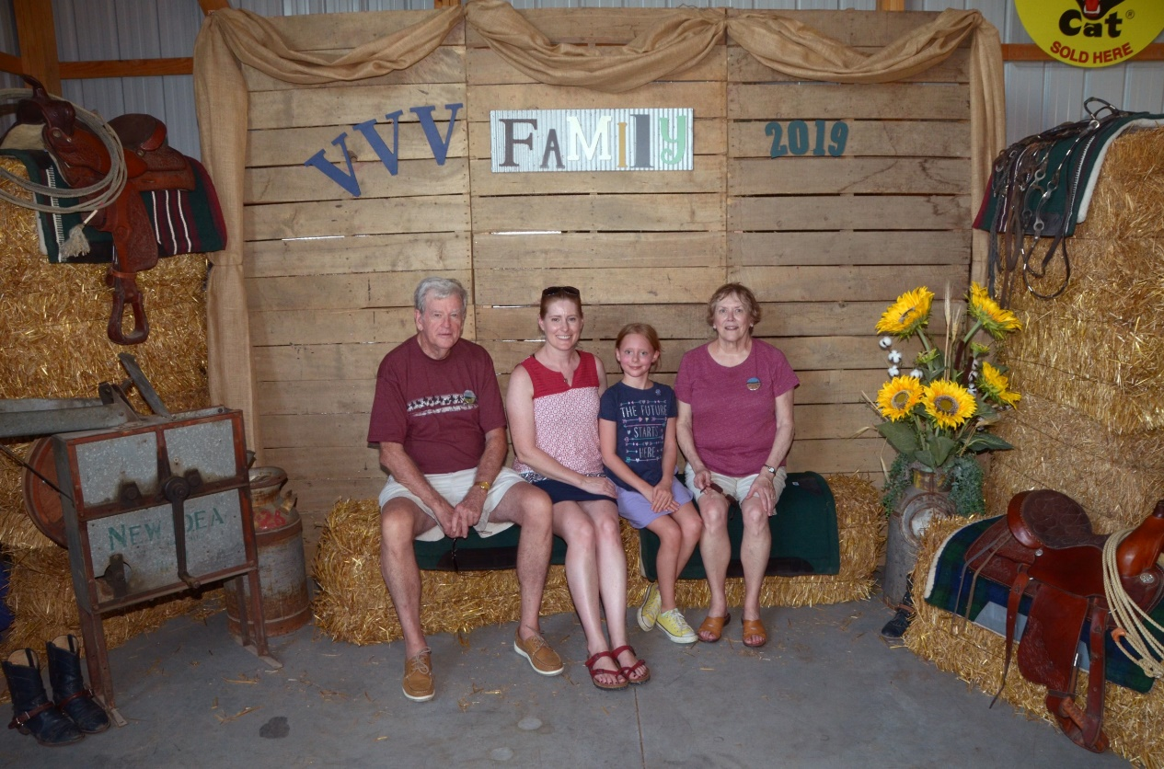
Tom Hood, Julie McMorrow, Ella McMorrow, and Wilma Hood.
Sue Vawter

Slide 21
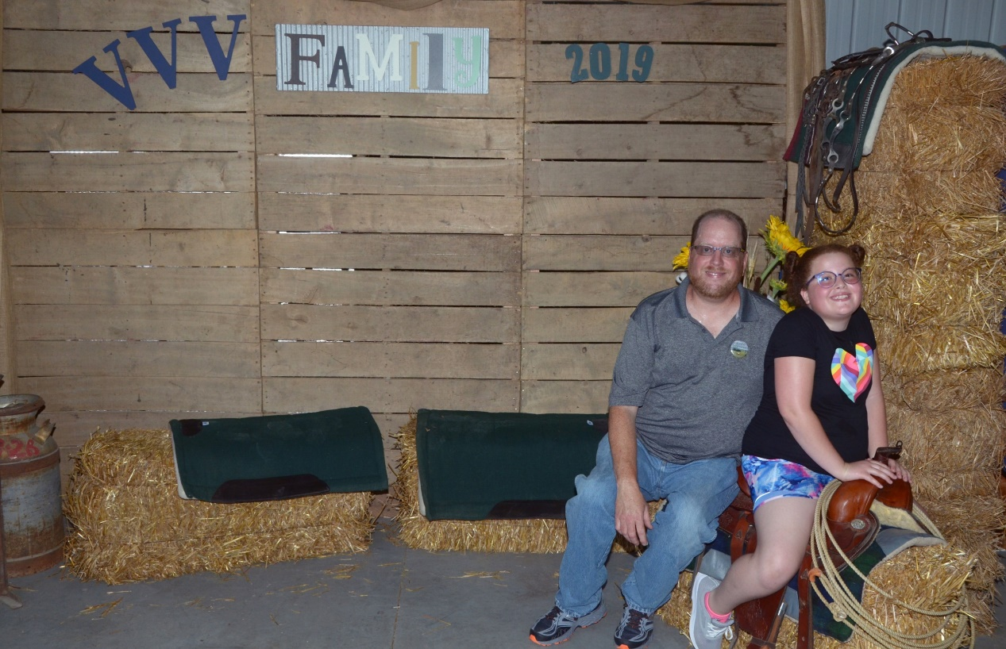
Shirley Leiker and Bill Vawter, Jr.
Mark Beasley and Karissa

Slide 22
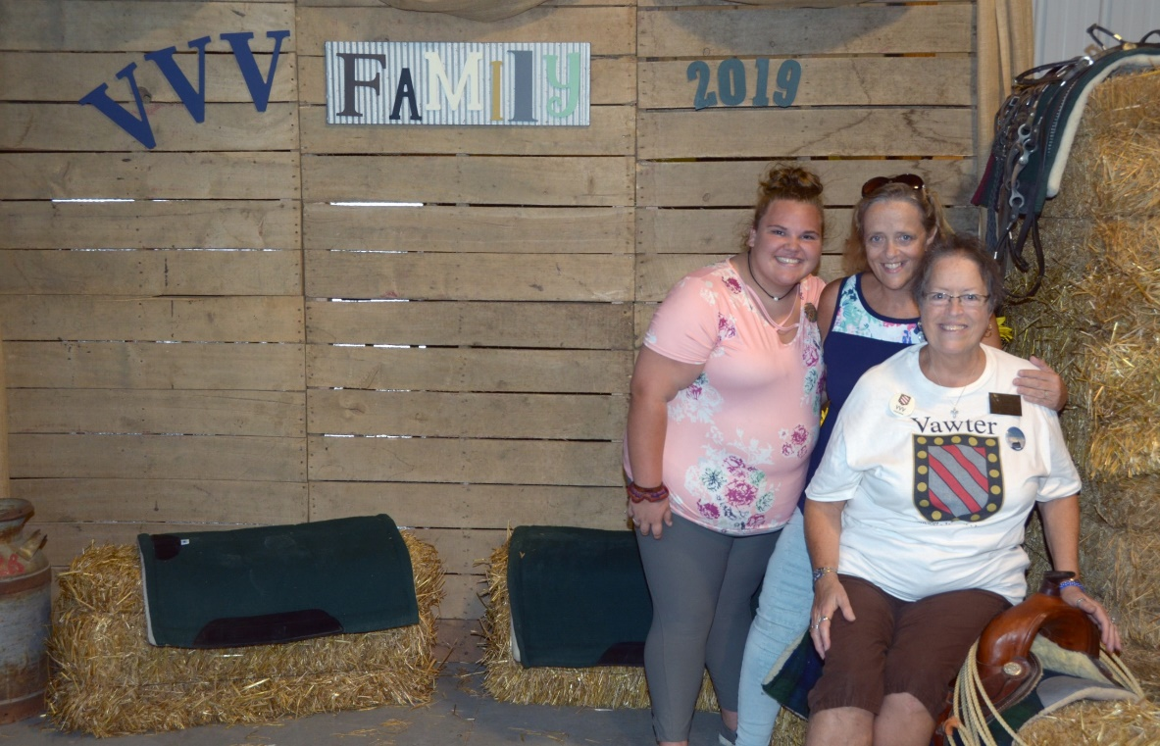
Jason Vawter and Lilah
Reba and Michelle Alexander
with Shirley Beasley

Slide 23
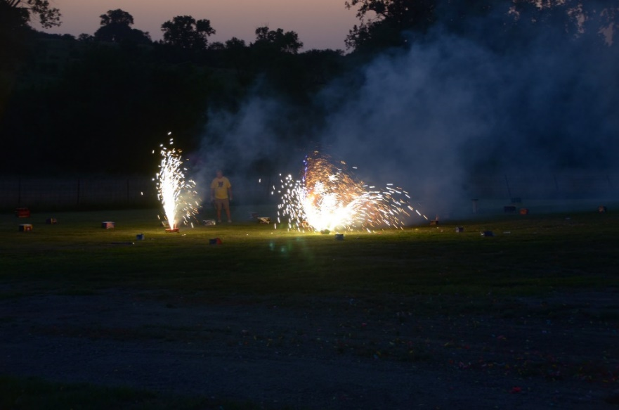
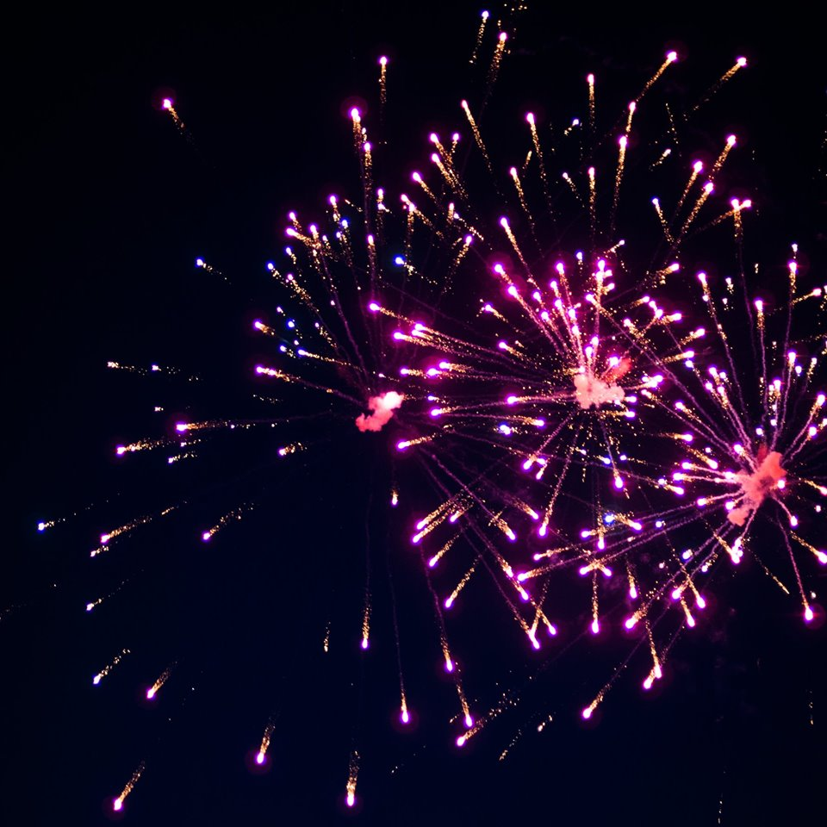
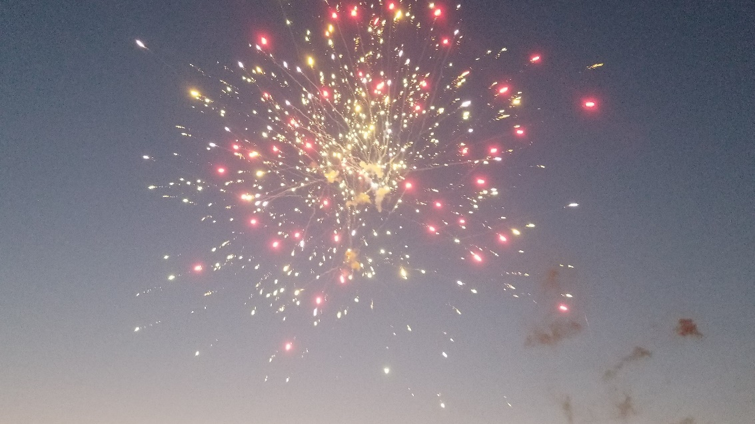
And the fireworks…..

Slide 24
The Friday morning meeting Bob Vawter, President

Slide 25
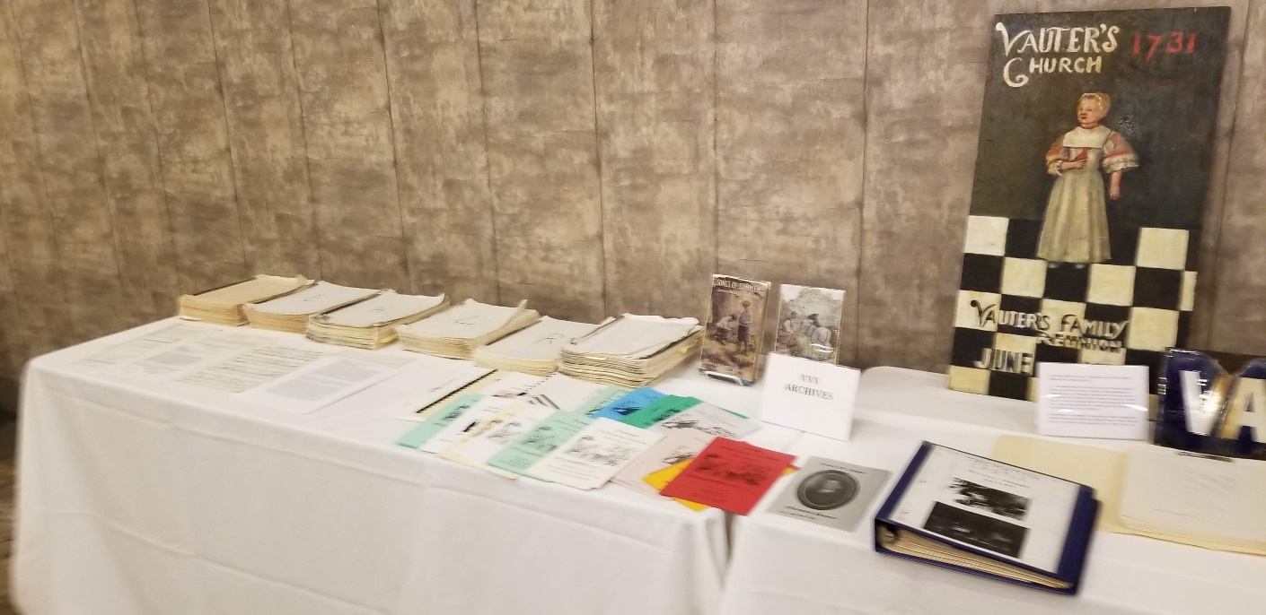
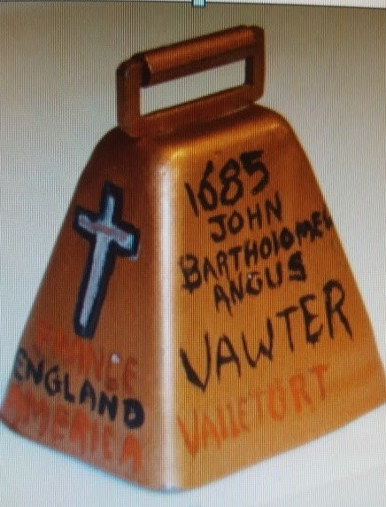
Some of the archives

Slide 26
Genealogy session with Georgene Jurgensen

Slide 27
Jim Vaughters also gave a genealogy report

Slide 28
A visit to the homestead of Jeptha Dudley “JD” Vawter, built in 1865 near Wakarusa, Kansas.

Slide 29
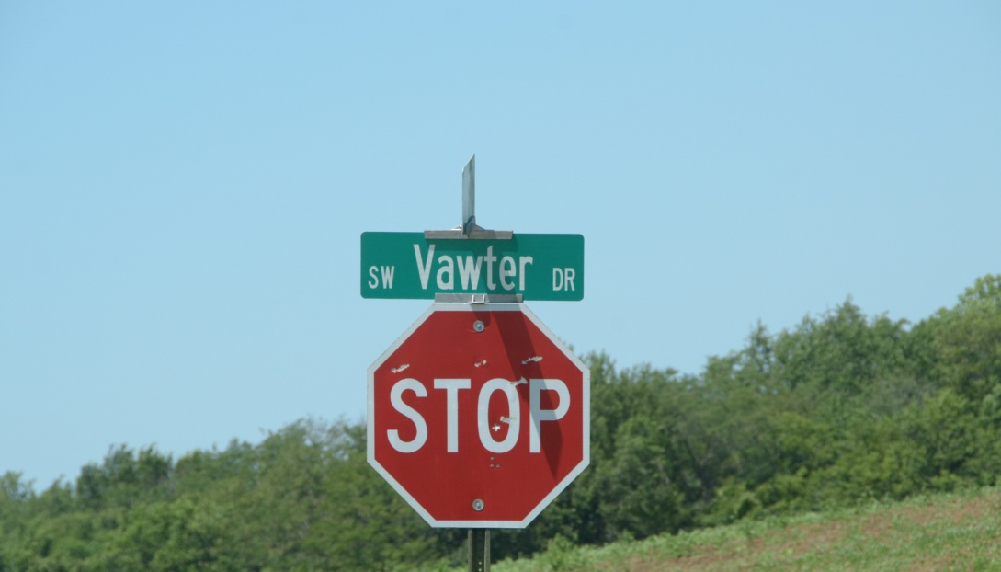
Tour of the Vawter Cemetery located just east of the Jeptha Dudley “JD” Vawter homestead. Known burials are JD, his wife Sarah, and two grandchildren, Imogene Stout and Alberta Stout.

Slide 30
Re-enactment of Bleeding Kansas in Lecompton.

Slide 31
And the banquet

Slide 32
President Bob Vawter opened the meeting (Michael McNary and Jordan Johnston at the table)

Slide 33
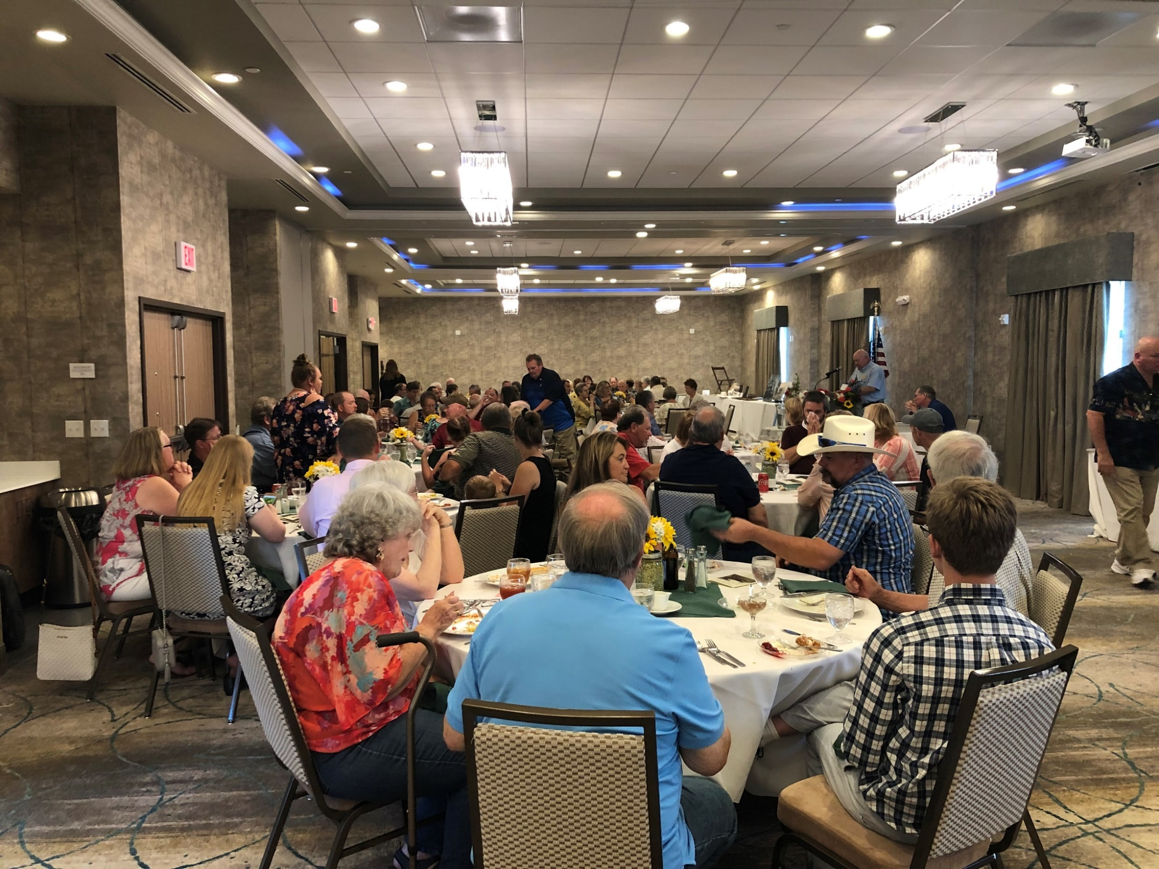

Slide 34
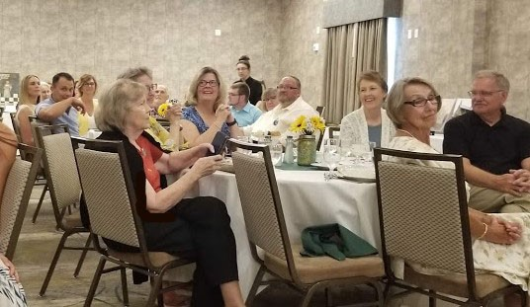

Slide 35
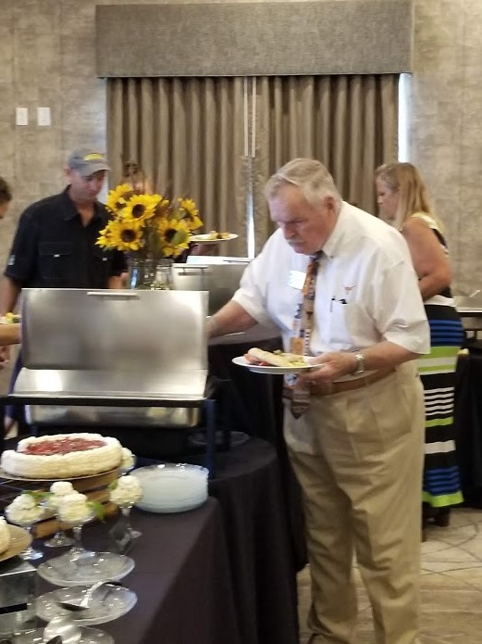
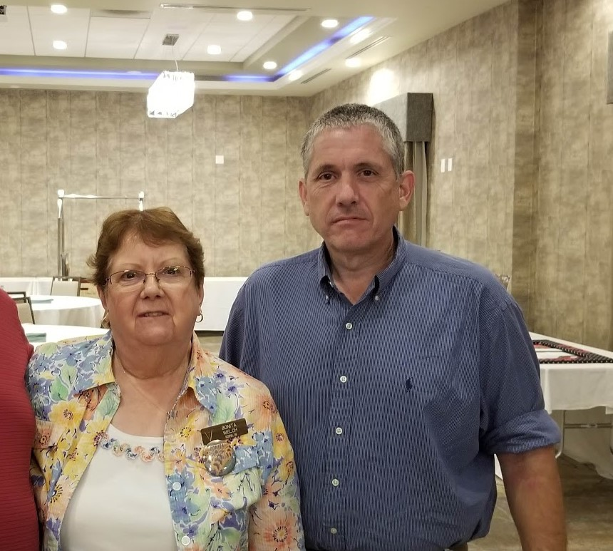
Phil Vaughter
Bonita and Darren Welch

Slide 36
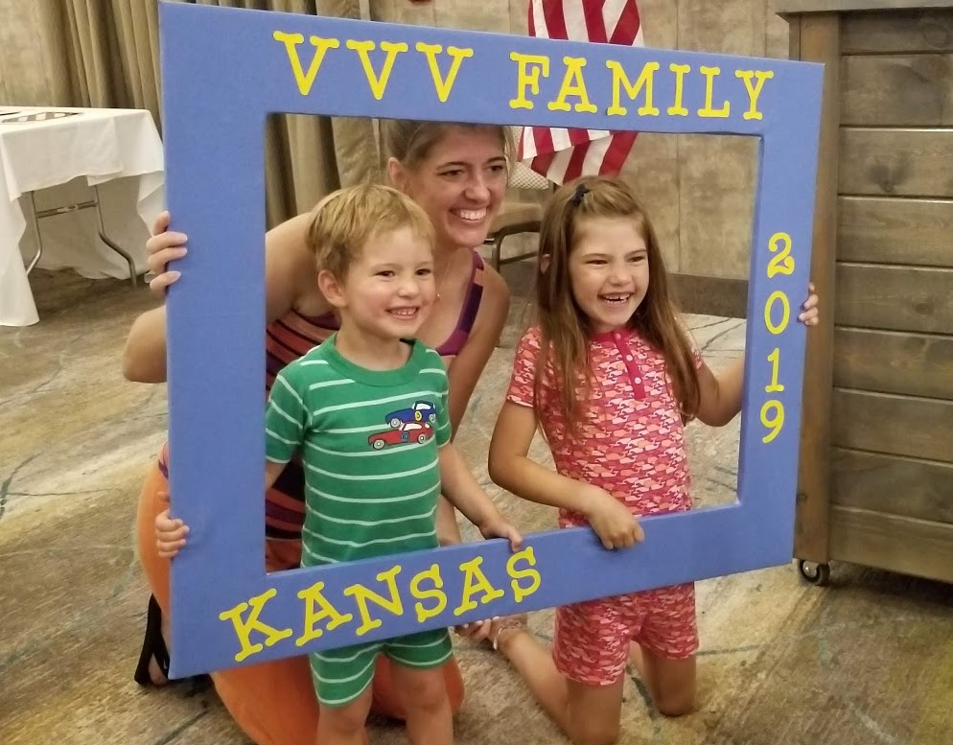
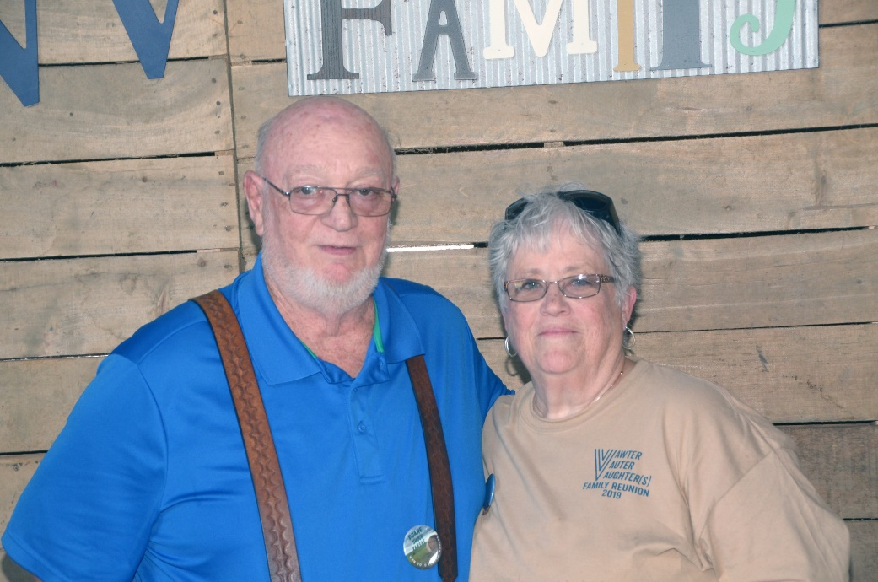
Sarah Palodichuk with Ella and Tyler
Duane and Lois Shuck

Slide 37
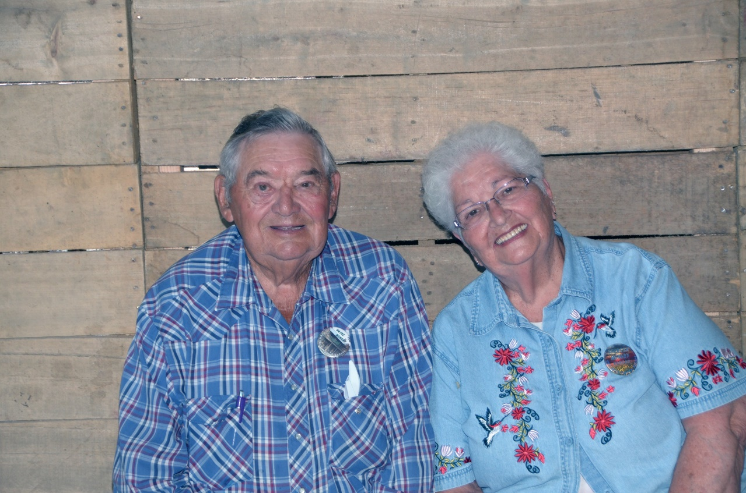
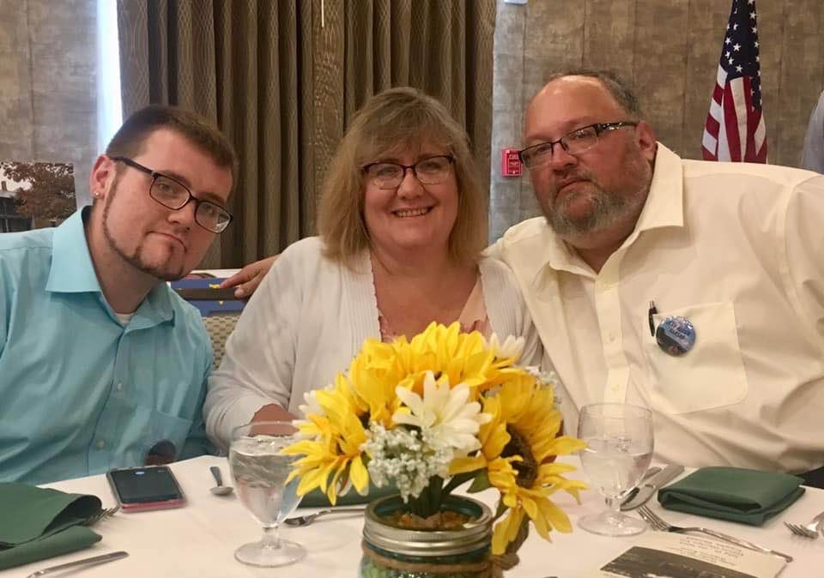
Lewis Wayne and Theresa McNary
Joshua Douglas, Leslie & Jeff Allen

Slide 38
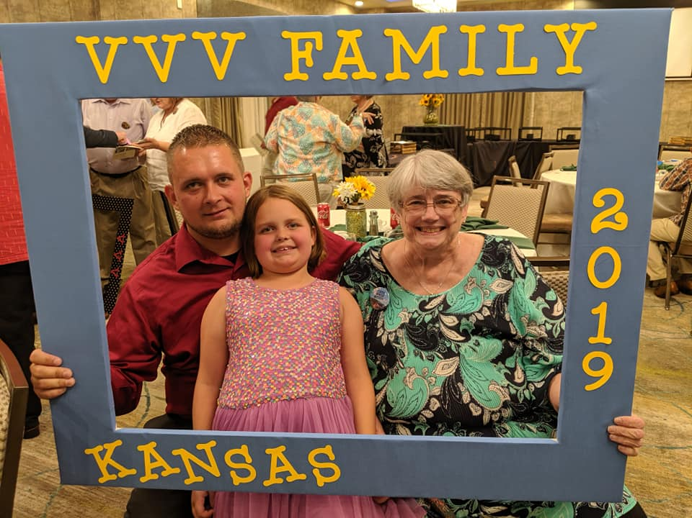
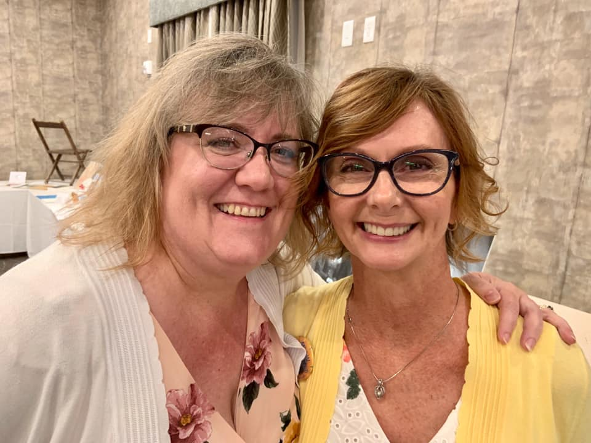
Jason, Lilah and Linda Vawter
Leslie Allen and Micki Self Loveland

Slide 39
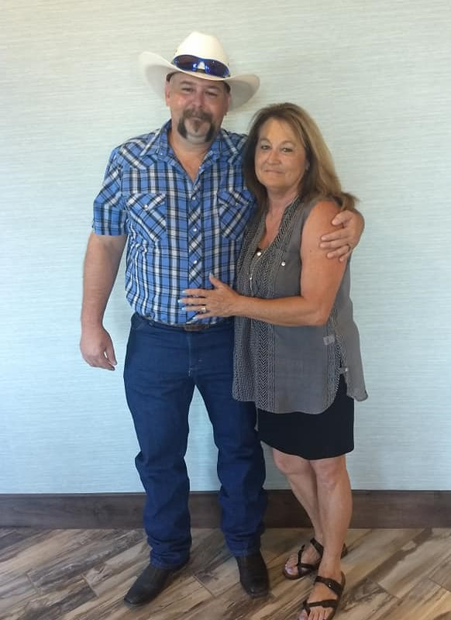
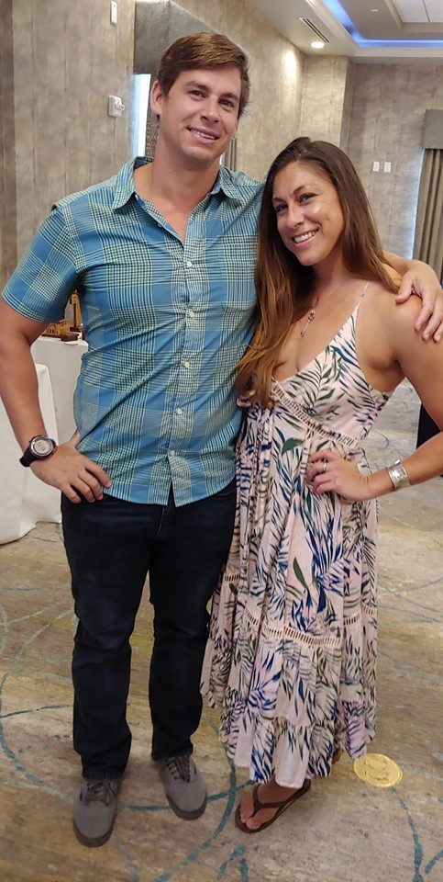
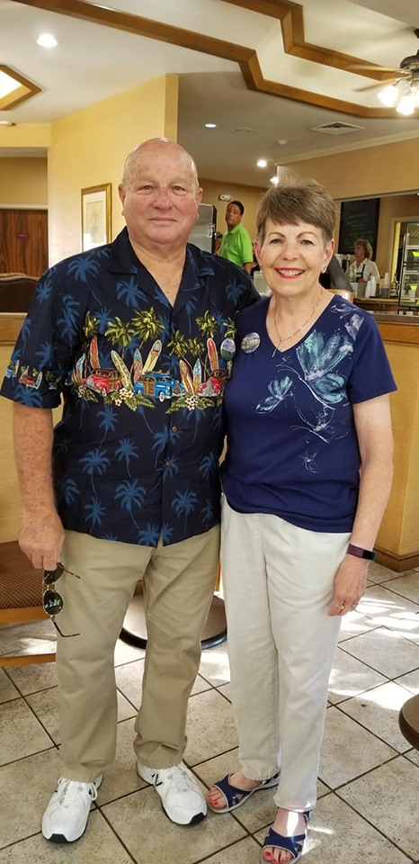
Will and Debbie Mumert
Frederick Cummings and Rebecca Cummings
Charles and Mary Wilhelm

Slide 40
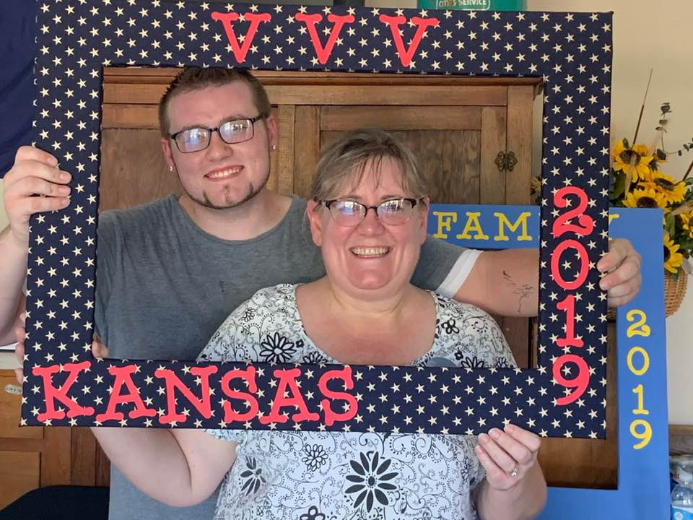
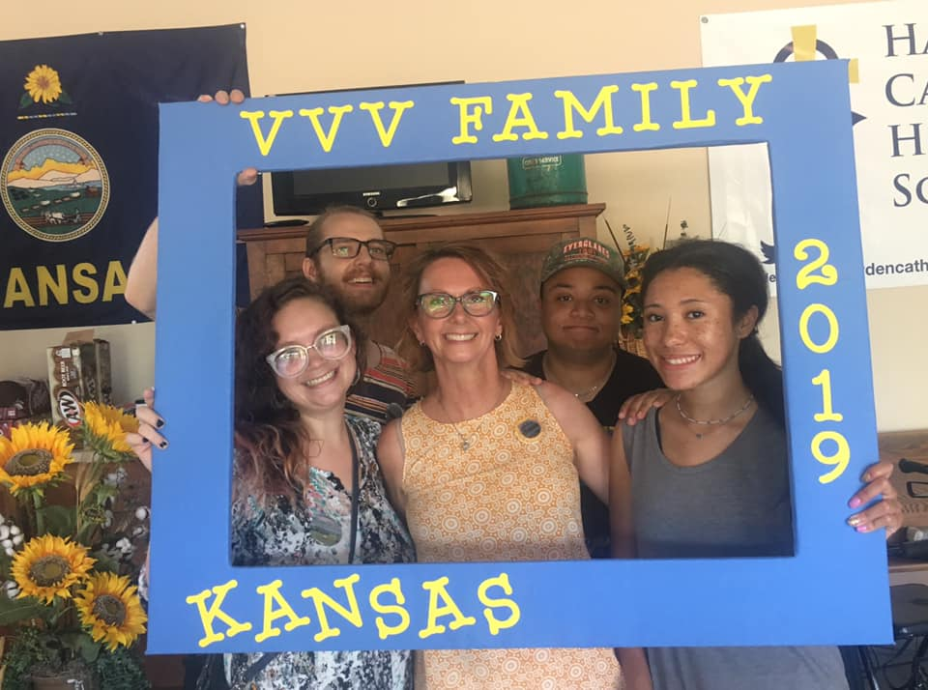
Joshua Douglas and Leslie Allen
Audrianna Brandley, Steven Stewart, Micki Self Loveland, Mon Wilcox, and Malayah Demby.

Slide 41
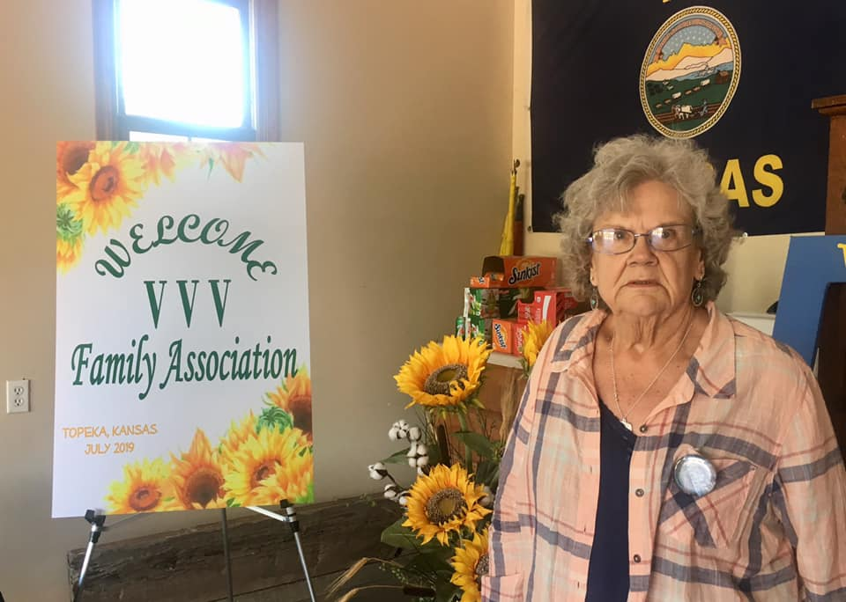
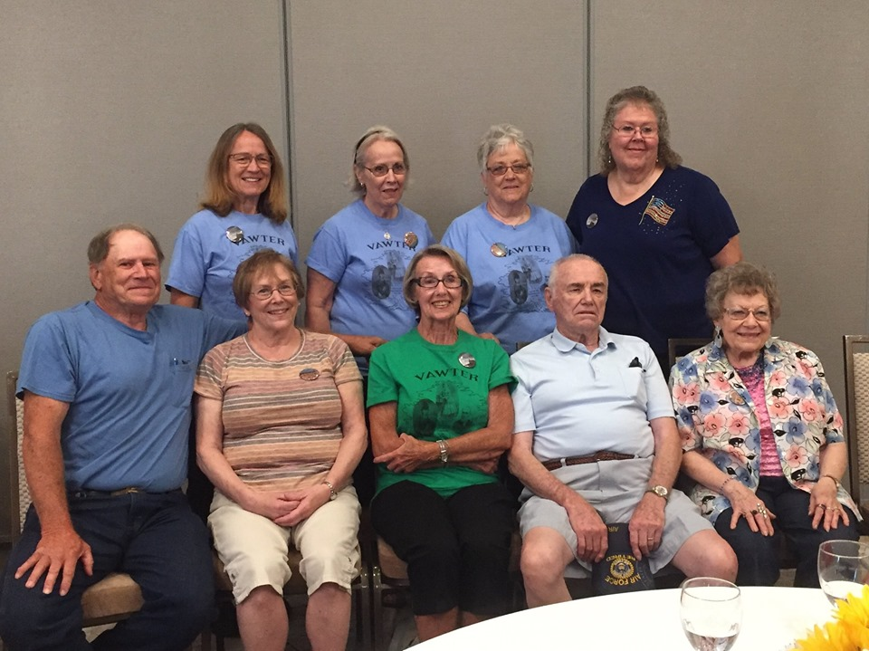
Laura Mumert
Front Row: Larry Slater, Wilma Hood, Doris Knutsen, Morris Slater, Jr., Marjorie Shafer. Back row: Mary Burgett, Nancy Southard, Lois Shuck, Vicki Vawter.

Slide 42
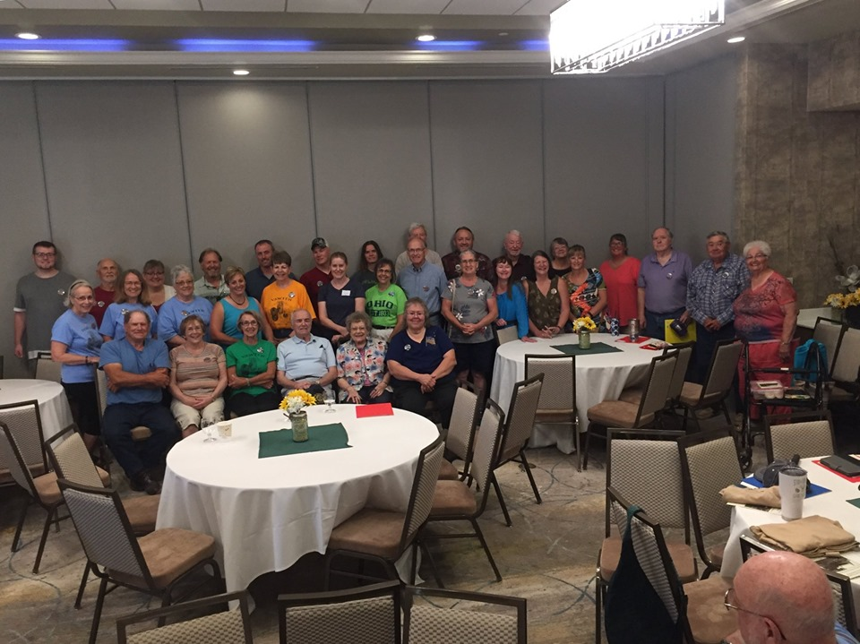
Most
Of
The
Kansas
Cousins

Slide 43
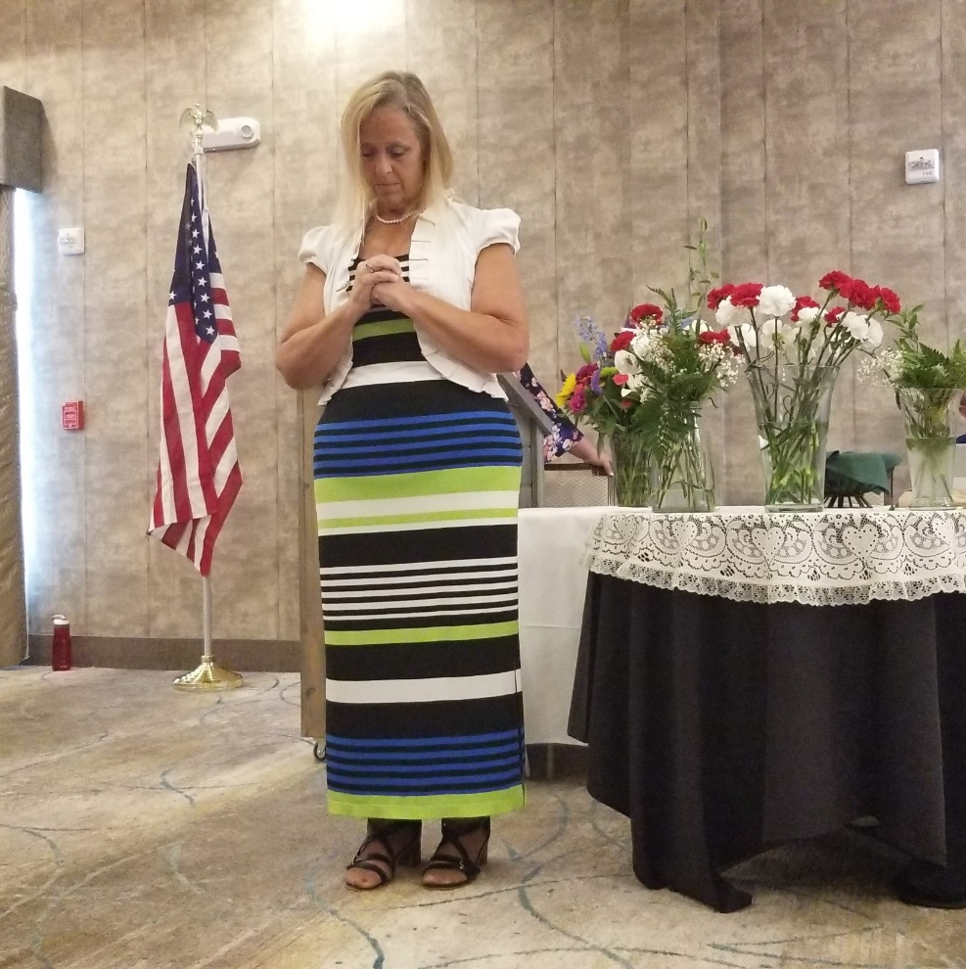
The memorial service By Ellen and Michelle

Slide 44
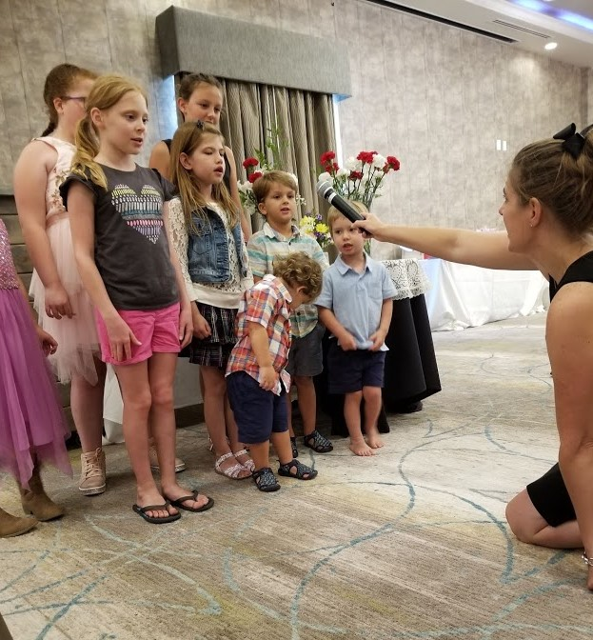
Sarah Palodichuk leads the VVV Family Children’s Choir.

Slide 45
The auction included many interesting items . The proceeds go to the Vauter Church

Slide 46
Many thanks to those cousins who sent in the pictures. Especially Bob, Brad and Michael

